Slide 1















Sentiment Analysis for Early Detection of Mental Health Status
By Prakash Parajuli email: prakashparajuli2046@gmail.com

Slide 2

Objectives:
Develop a Multi-Class Classification Model: Build and implement a predictive model to accurately classify various mental health statuses, such as "Normal," "Depression," "Suicidal," "Anxiety," "Bipolar," "Stress," and "Personality disorder," based on textual statements.
Explore and Evaluate Machine Learning Algorithms: Investigate and compare the performance of Bernoulli Naive Bayes, Logistic Regression, and Decision Tree Classifier to identify the most effective model for sentiment analysis in mental health.
Facilitate Early Detection of Mental Health Issues: Create a prototype tool that enables healthcare providers to monitor and trigger timely interventions based on predicted mental health statuses, ultimately improving patient care outcomes.

Slide 3
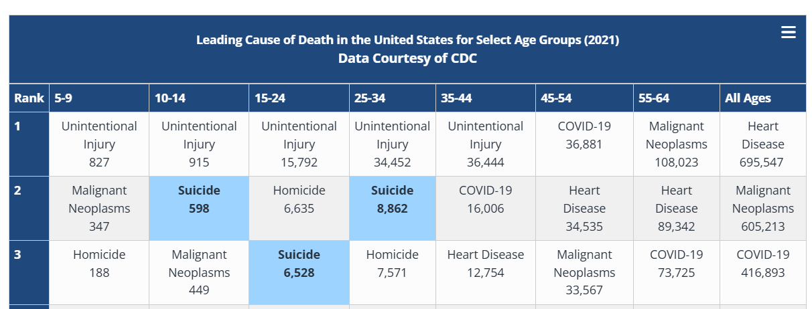
Suicide among the leading causes of death
Source: https://www.nimh.nih.gov/health/statistics/suicide

Slide 4
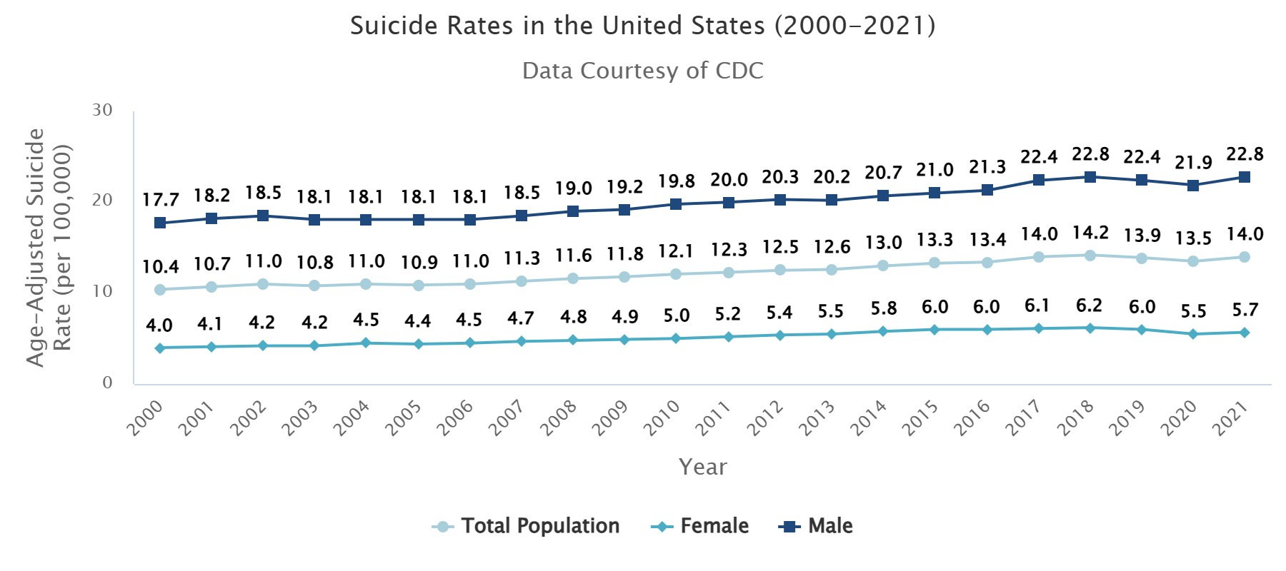
Suicide Rates over Time
Source: https://www.nimh.nih.gov/health/statistics/suicide

Slide 5
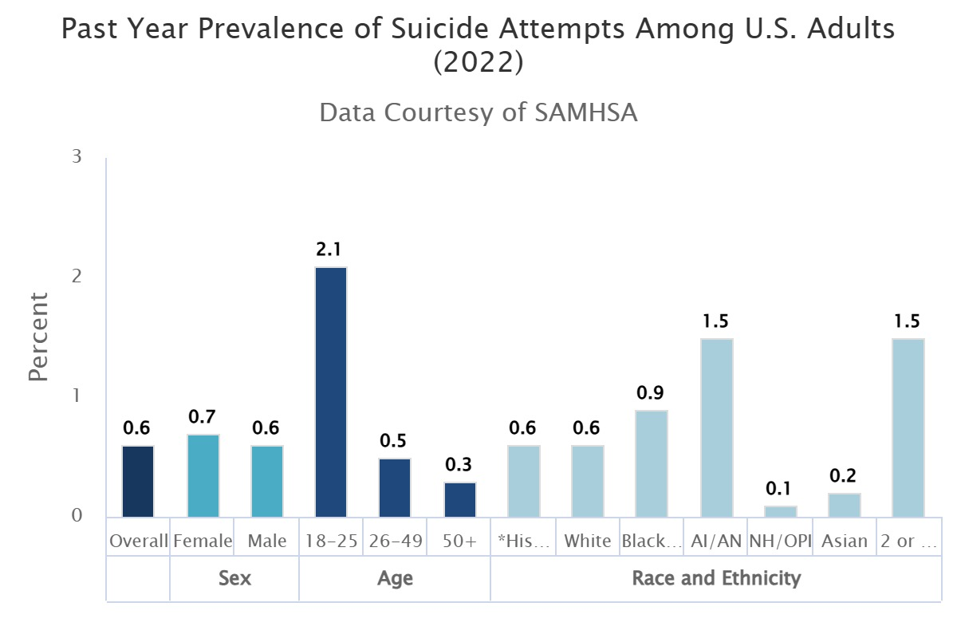
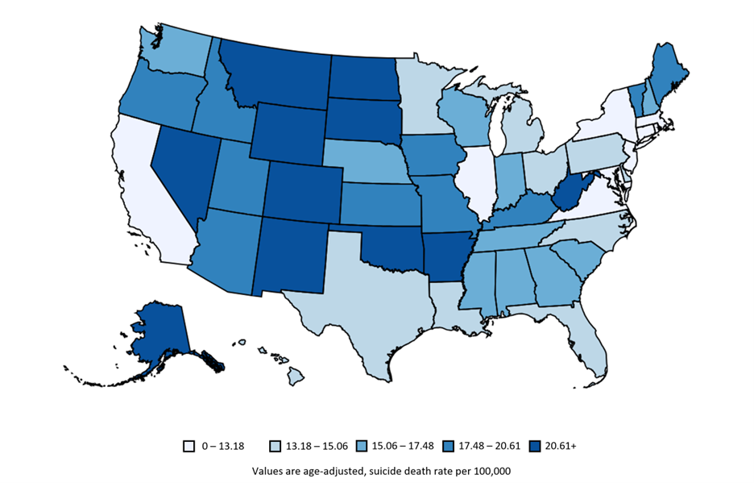
Suicidal Attempts and death Among U.S. Adults (2022)
Source: https://www.nimh.nih.gov/health/statistics/suicide

Slide 6
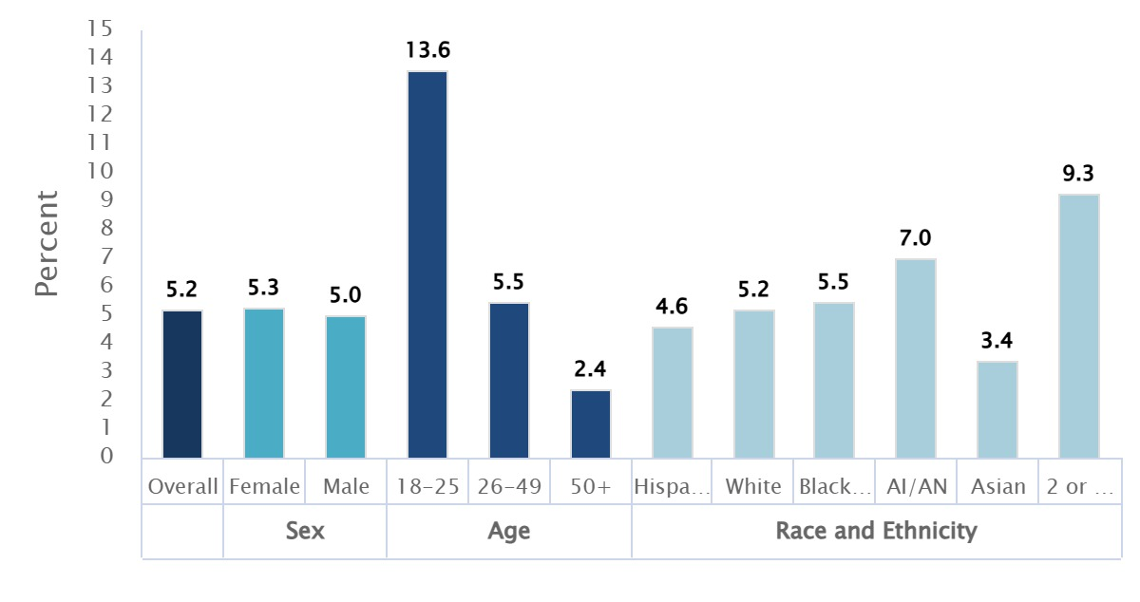
Suicidal thoughts Among U.S. Adults (2022)
Source: https://www.nimh.nih.gov/health/statistics/suicide

Slide 7
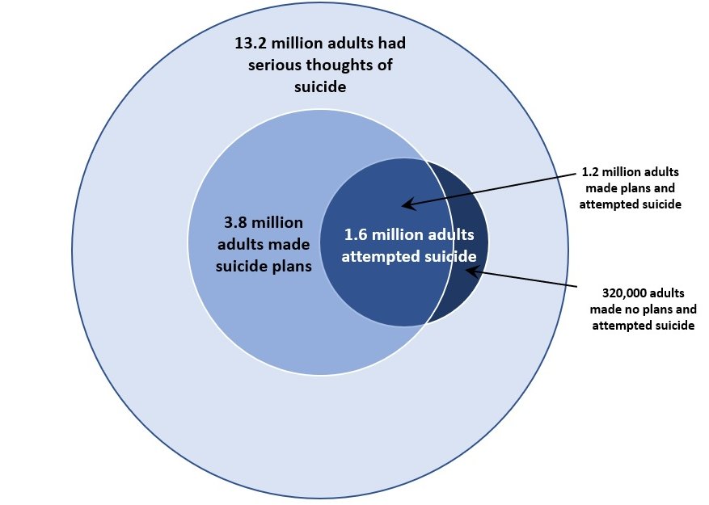
It’s the THOUGHT that counts
Source: https://www.nimh.nih.gov/health/statistics/suicide

Slide 8
Dataset Overview:
The dataset comprises 53,043 statements derived from various sources.
statement: The textual data or post representing an individual's mental health status.
status: Categorical labels indicating the mental health condition, including:
Normal,
Depression,
Suicidal,
Anxiety,
Bipolar,
Stress,
Personality Disorder
The dataset has been compiled by Suchintika Sarkar and integrates information from multiple Kaggle datasets, ensuring a rich and diverse resource for analysis.

Slide 9
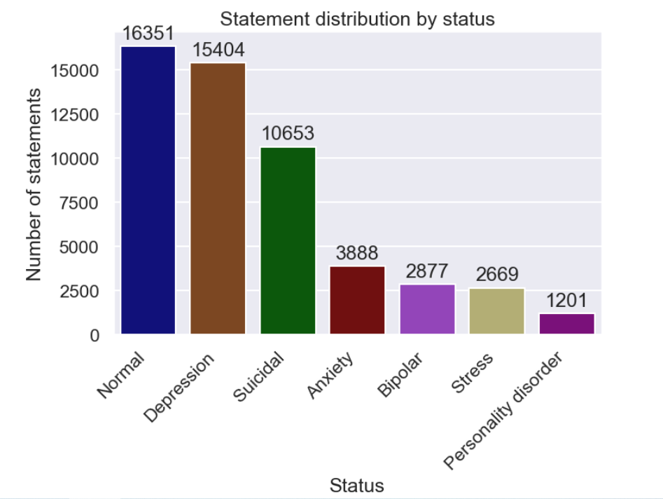
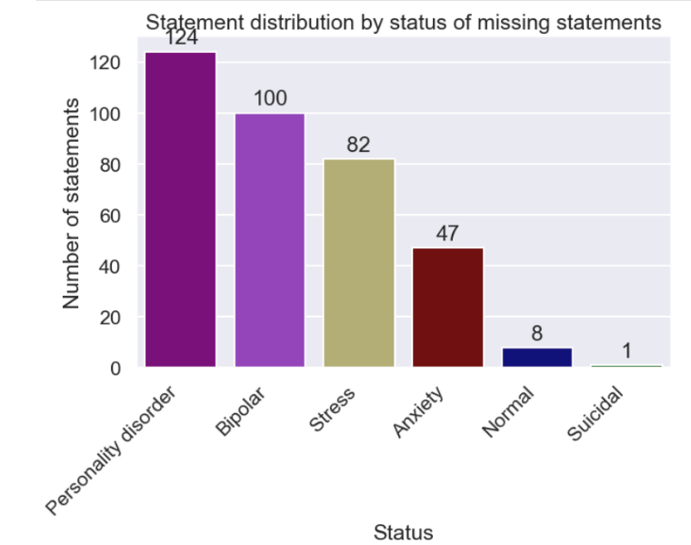
Data Wrangling: missing statements
13.6:1 ratio between the most and least common categories.

Slide 10
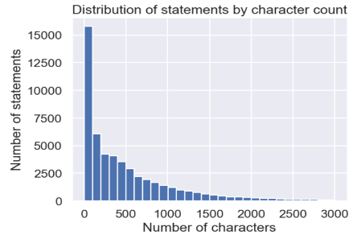
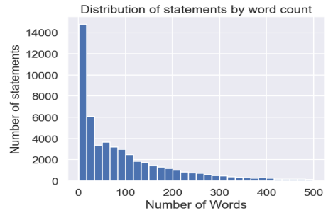
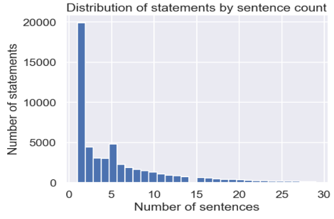
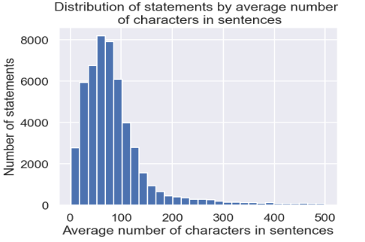
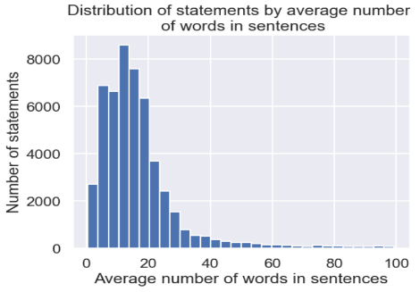
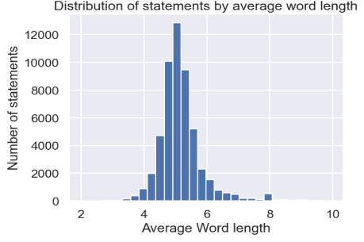
Feature Engineering and Exploratory Data Analysis:

Slide 11
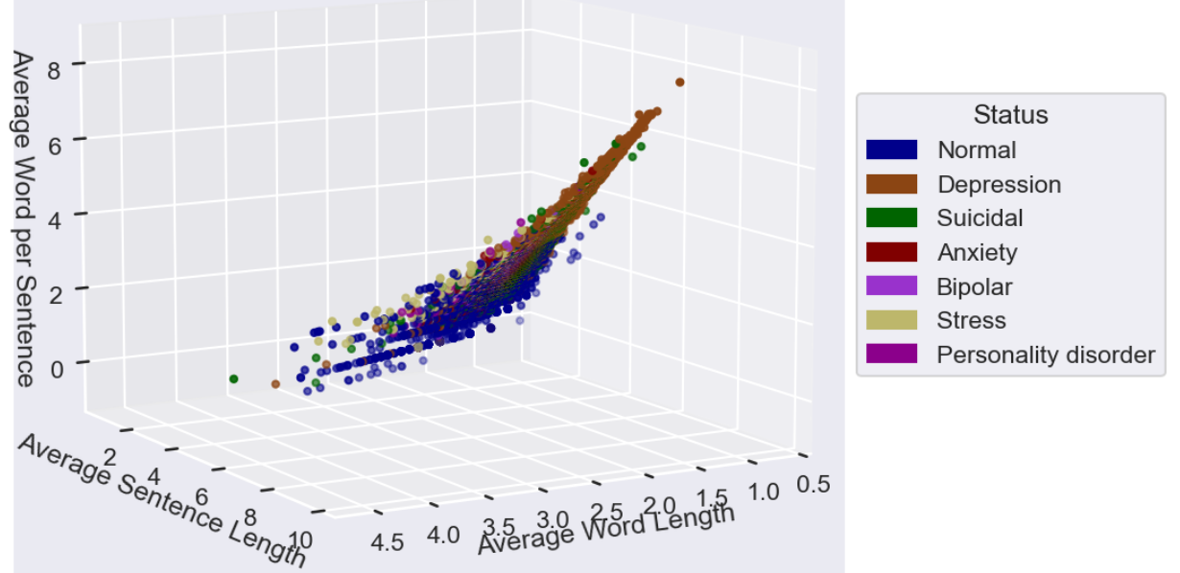
Exploratory Data Analysis:

Slide 12
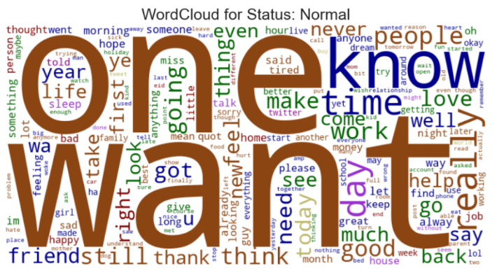
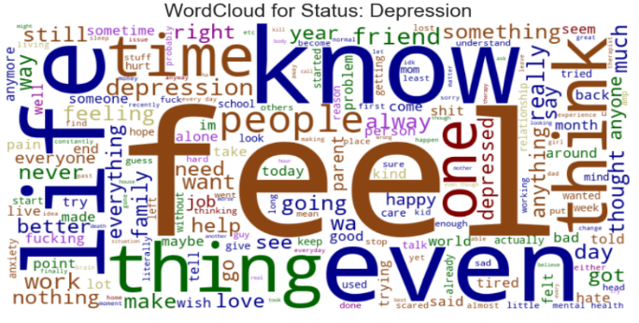
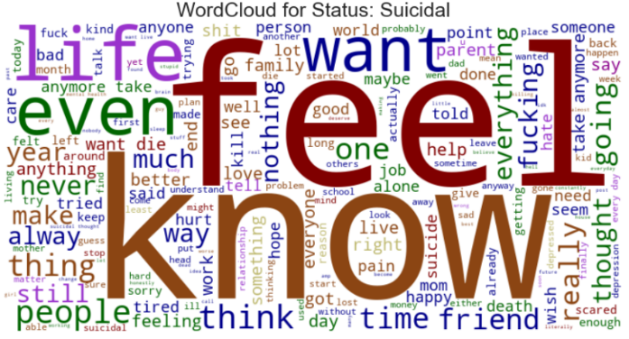
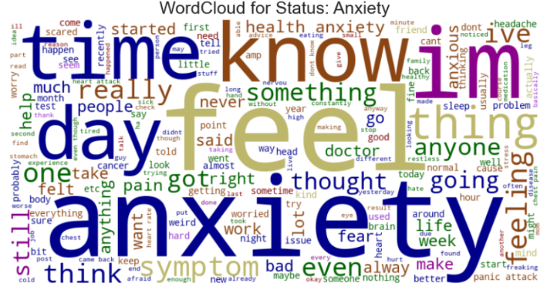
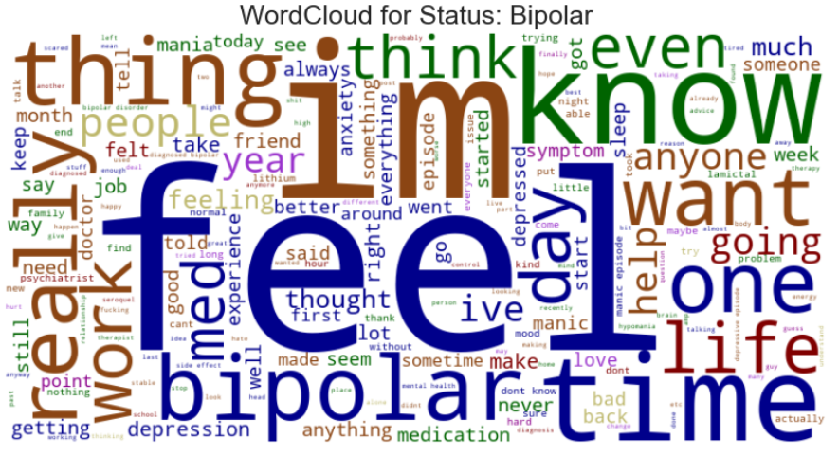
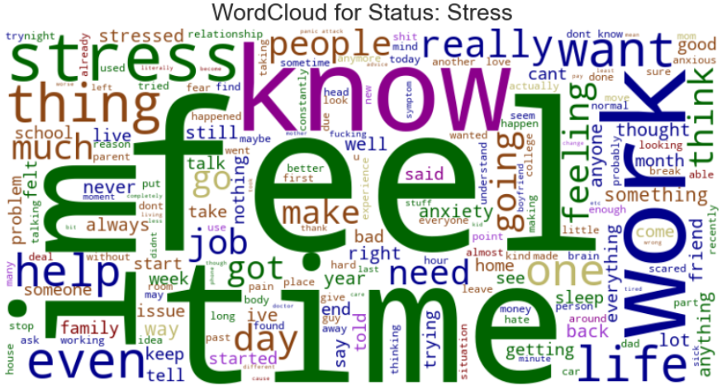
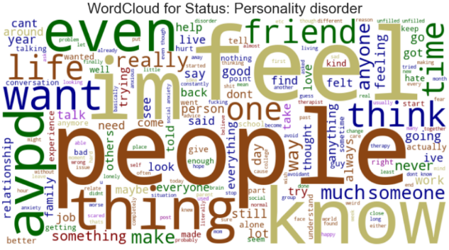
Relative importance of words in each status category
Many words such as "feel", "know" etc. are used with overlap across different statuses.
It must be taken care of while building a model.
TF-IDF (Term Frequency-Inverse Document Frequency) is an excellent way to handle the overlap of words across different categories in NLP.

Slide 13

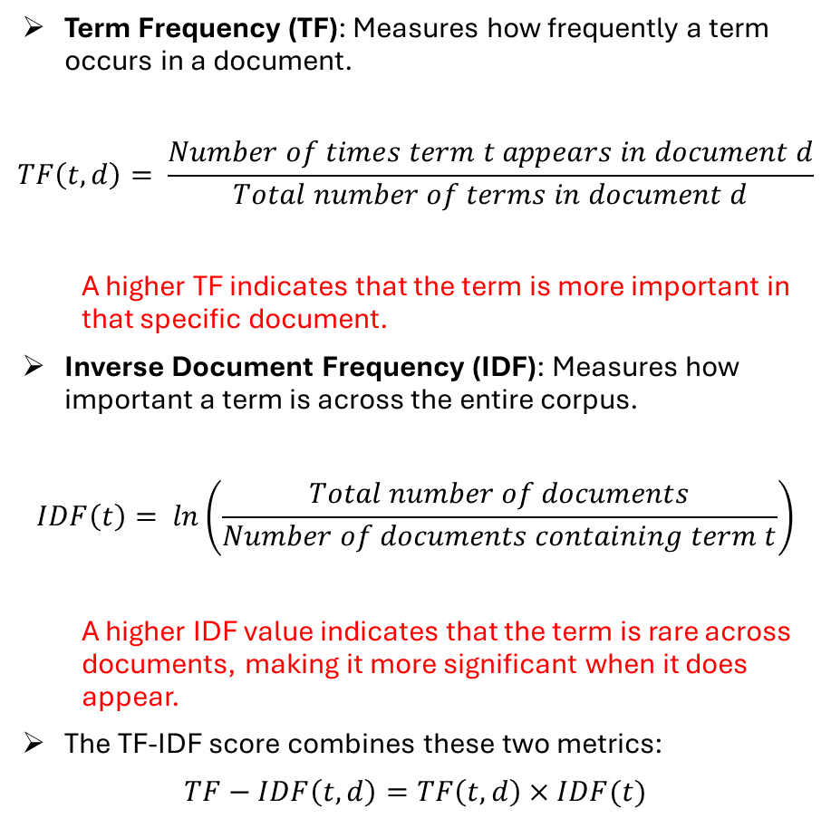
TF-IDF vectorization
Term Frequency (TF): Measures how frequently a term occurs in a document.
$$TF\left(t,d\right)= \frac{Number of times term t appears in document d}{Total number of terms in document d}$$
A higher TF indicates that the term is more important in that specific document.
Inverse Document Frequency (IDF): Measures how important a term is across the entire corpus.
$$IDF\left(t\right)= ln\left(\frac{Total number of documents}{Number of documents containing term t}\right)$$
A higher IDF value indicates that the term is rare across documents, making it more significant when it does appear.
The TF-IDF score combines these two metrics:
$$TF−IDF\left(t,d\right)=TF\left(t,d\right)×IDF(t)$$

Slide 14
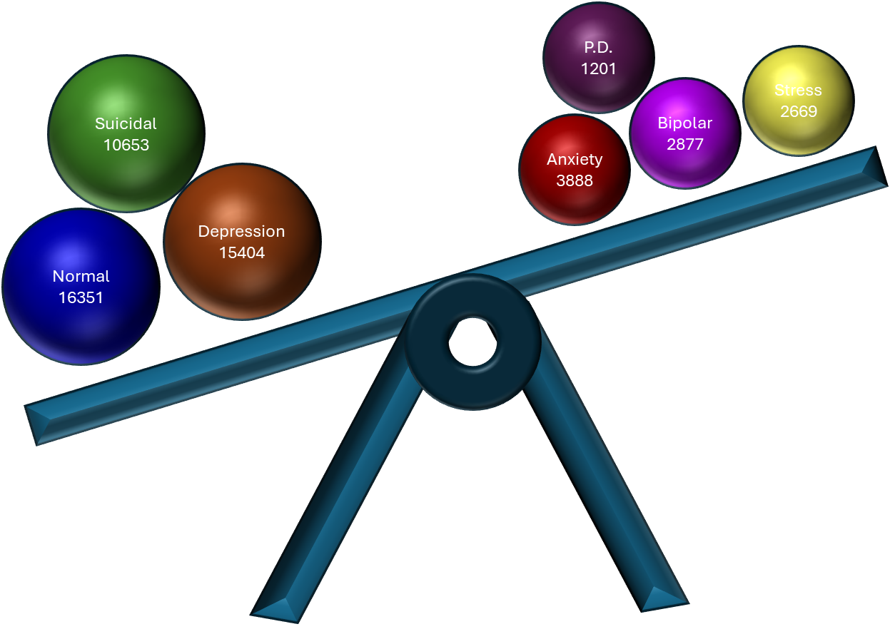
Category imbalance and the resampling
SMOTE (Synthetic Minority Over-sampling Technique): Generates synthetic samples but may not always capture the underlying distribution effectively.
RandomOverSampler : Effectively increased the number of instances in the minority classes by randomly duplicating existing examples, which allowed the model to better learn from these underrepresented classes.
The RandomOverSampler provided significantly better results in terms of model performance.

Slide 15
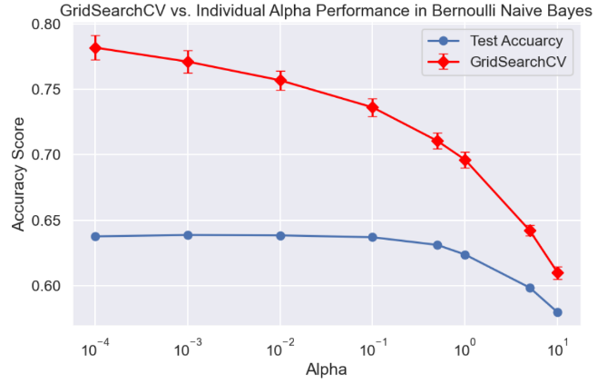
Model1: Bernoulli Naive Bayes
GridSearchCV indicated that the optimal alpha was 0.0001 with a cross-validated accuracy of approximately 78.20%, the accuracy on the test set for this same alpha was significantly lower at 63.76%.
The discrepancy suggests that the model may have been overfitting during cross-validation or that the training data used in GridSearchCV did not accurately represent the diversity of the test data.
The results from individual testing of alpha values show a slight increase in accuracy for 0.001 and 0.01.

Slide 16
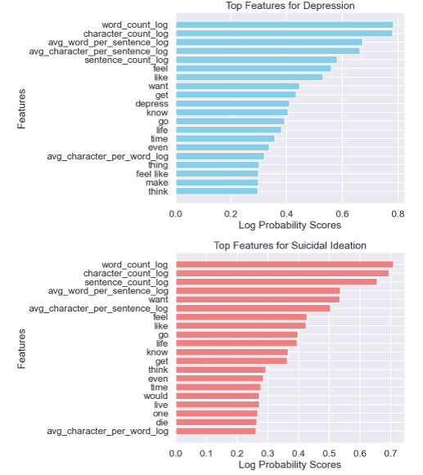
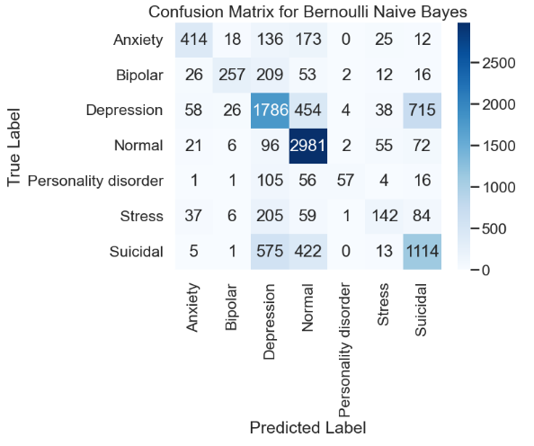
Model1: Bernoulli Naive Bayes

Slide 17
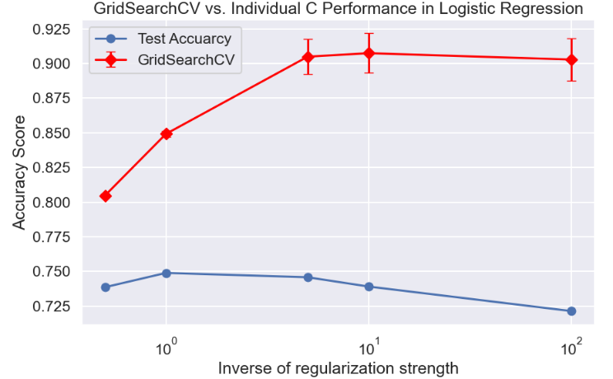
Model2: Logistic Regression classifier
GridSearchCV indicated that the optimal C was 10 with a cross-validated accuracy of approximately 90.75%, the accuracy on the test set for this same C was significantly lower at 73.91%.
The discrepancy suggests that the model may have been overfitting during cross-validation or that the training data used in GridSearchCV did not accurately represent the diversity of the test data.
The results from individual testing of C values show a slight increase in accuracy for 10 (73.91% accuracy) and 1 (74.89% accuracy).

Slide 18
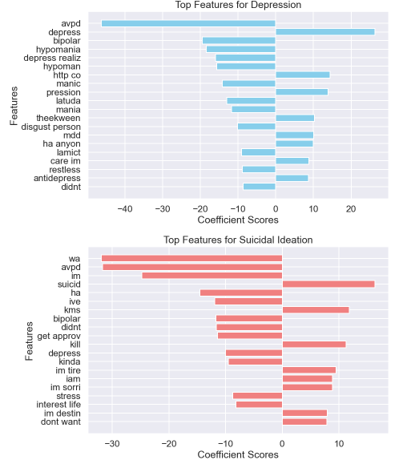
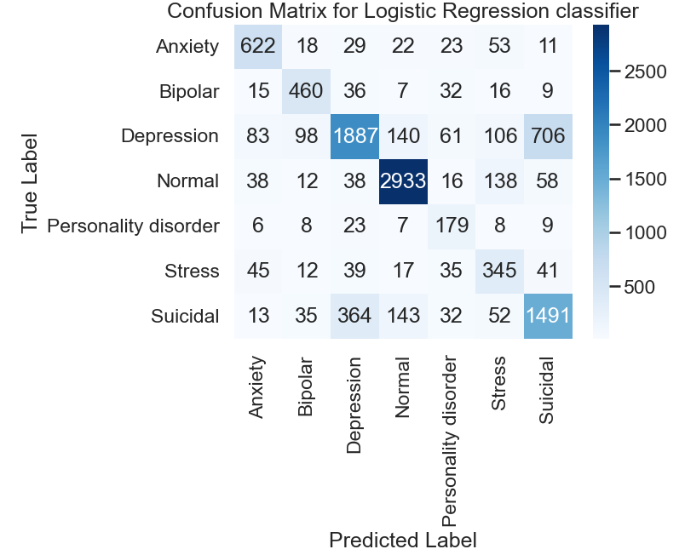
Model2: Logistic Regression classifier

Slide 19
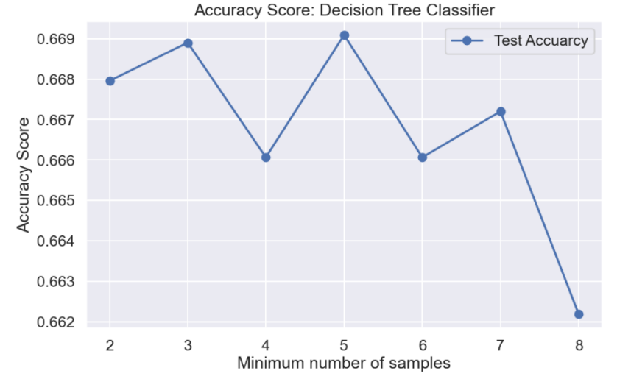
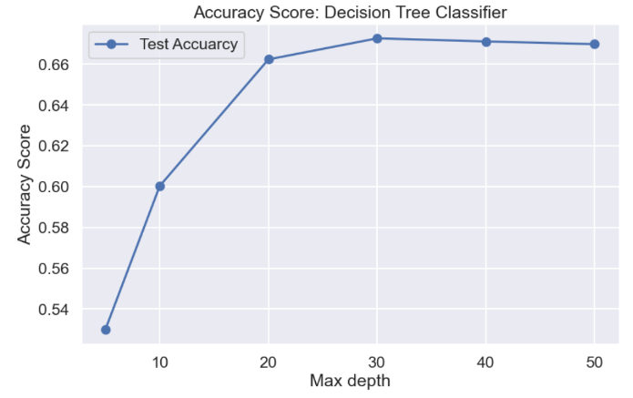
Model3: Decision Tree Classifier

Slide 20
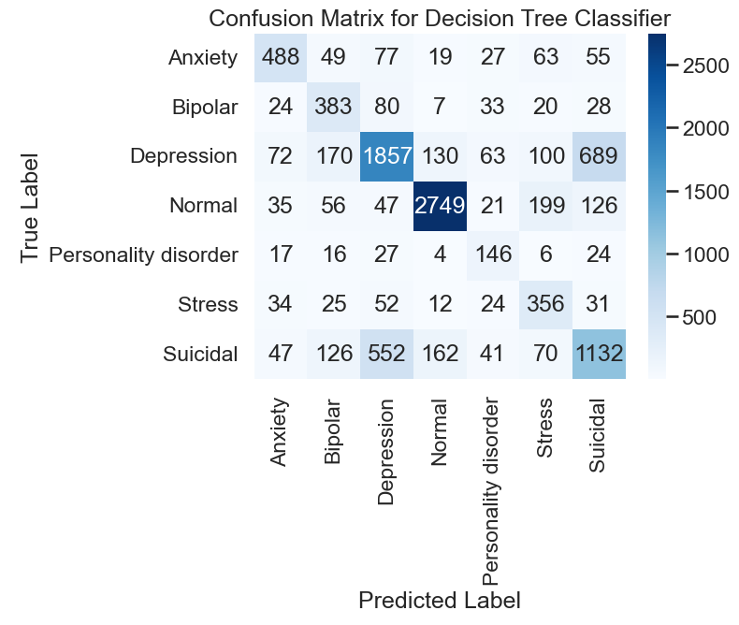
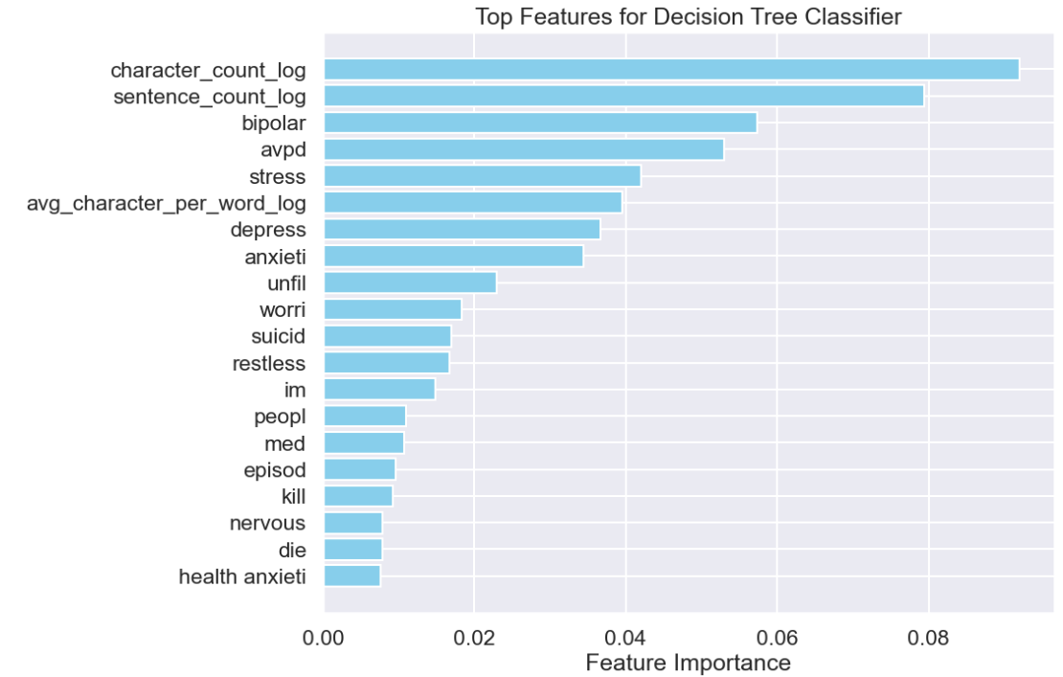
Model3: Decision Tree Classifier

Slide 21
Conclusions:
The Logistic Regression model outperformed both the Decision Tree Classifier and the Bernoulli Naive Bayes, achieving the highest accuracy of approximately 74.89% on test sample for C = 1.0 (approx. accuracy of 90.75% by GridSearchCV with best C = 10.0) .
Both the Decision Tree Classifier and the Bernoulli Naive Bayes exhibited significant misclassification issues, particularly in differentiating between the "Depression" and "Suicidal" classes. This indicates a potential overlap in feature representation for these categories, suggesting that further feature engineering, additional data, or more complex models may be necessary to improve classification performance in these areas.
The decision to manually test various hyperparameters for the Decision Tree Classifier, rather than relying on GridSearchCV, highlights the importance of balancing model optimization with computational efficiency. While GridSearchCV can provide thorough parameter tuning, it can be time-consuming.

Slide 22
Future Recommendation:
Expand Dataset with Additional Data Collection: Increase sample size for low-sampled classes by gathering data from trusted sources via web scraping, APIs, or open datasets, enhancing model robustness.
Increase Computational Resources: Utilize cloud computing (AWS, Google Cloud) or distributed computing (e.g., Dask, Spark) to handle complex models and hyperparameter tuning, allowing for more extensive experimentation.
Leverage Pre-Trained Models with Fine-Tuning: Use pre-trained NLP models (e.g., BERT, RoBERTa) and fine-tune them with your dataset, achieving high accuracy efficiently by capitalizing on existing language understanding

Slide 23
Acknowledgment
Suchintika Sarkar for making the dataset publicly available,
Vinit Koshti, for his insightful guidance and thoughtful advice.

Slide 24

Thank you!
Thank you!

